Slide 1
Gabinete de Promoção dos Programa Quadro ID&I
Oportunidades de financiamento H2020
TIC e Infraestruturas Digitais
João Mil-Homens
Aveiro, Universidade de Aveiro
05/11/2015

Slide 2
Programa Trabalhos ICT 2016-17
39 tópicos
8 cooperação internacional
Focus Areas
Factories of the Future, Internet of Things, Smart Cities, Digital Security
Desafios Societais
SME Instrument e Fast Track
JU ECSEL

Slide 4
ICT 2016-2017
Gabinete de Promoção dos Programa Quadro ID&I

Slide 5
ICT Work programme 2016-2017
Components and Systems
Advanced Computing and Cloud Computing
Future Internet
Content
Robotics
KETs: Micro-nano-electronics and Photonics
Innovation & Entrepreneurship
Responsibility & Creativity
International Cooperation

Slide 6
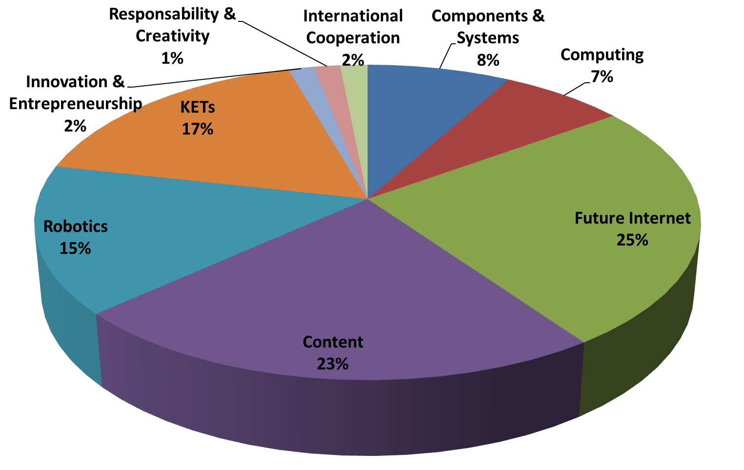

Slide 7
Orçamento por área do WP

Slide 8
Datas Importantes
19/01/16 - EU-Japan e EU-South Korea
12/04/16 - ICT-2016-1
20/09/16 - ICT-2016-2
14/03/17 - EU-Brazil
25/04/17 - ICT-2017

Slide 9
Components and Systems
ICT-01 - Smart Cyber-Physical Systems
ICT-02 - Thin, Organic and Large Area Electronics
ICT-03 - Smart System Integration
Advanced Computing & Cloud Computing
ICT-06 - Cloud Computing
Future Internet
ICT-10 - Software Technologies
ICT-12 - Net Innovation Initiative
ICT-13 - FIRE
Notes:
Technologies integration; user acceptability; business models
Pilots are autonomous entities - from supply side to demand side: use, application and deployment as well as the development, testing and integration activities
Multiple sites, scalability, large amount of real users are expected
- connection among cars and intelligent infrastructures
ecosystem of services around smarter and more autonomous vehicles
Test scenarios: safe and autonomous vehicles (SAE international level 5, full automation) in various representative use case scenarios, exploiting local and distributed information and intelligence; real-time platforms managing (car services, advanced sensors, efficient navigation and improved decision-making technology, interconnectivity between vehicles, vehicle to infrastructure communication)
showcase service ecosystems around cars/vehicles and mobility: multiple embedded information sources around which information services may be constructed - intelligent maintenance, personalised insurance, car organs behaviour monitoring, advanced security and autonomous trip management

Slide 10
Content
ICT-14 - Cross-sectorial cross-lingual data integration
ICT-15 - Large Scale Pilot
ICT-17 - Support, skills, benchmarking, evaluation
ICT-18 - Privacy-preserving big data technologies
ICT-21 - Support tech transfer to creative industries
ICT-22 - Technologies for learning and skills
ICT-24 - Gaming and gamification
Notes:
Technologies integration; user acceptability; business models
Pilots are autonomous entities - from supply side to demand side: use, application and deployment as well as the development, testing and integration activities
Multiple sites, scalability, large amount of real users are expected
- connection among cars and intelligent infrastructures
ecosystem of services around smarter and more autonomous vehicles
Test scenarios: safe and autonomous vehicles (SAE international level 5, full automation) in various representative use case scenarios, exploiting local and distributed information and intelligence; real-time platforms managing (car services, advanced sensors, efficient navigation and improved decision-making technology, interconnectivity between vehicles, vehicle to infrastructure communication)
showcase service ecosystems around cars/vehicles and mobility: multiple embedded information sources around which information services may be constructed - intelligent maintenance, personalised insurance, car organs behaviour monitoring, advanced security and autonomous trip management

Slide 11
Robotics
ICT-25 - Advanced robot capabilities
ICT-26 - Systems, development and pilot installations
KETs: Micro-nano-electronics and Photonics
ICT-29 - Photonics
Responsibility and Creativity
ICT-35 - Responsible ICT-related research & innovation
ICT-36 - Boost synergies between artists, creative people and technologists
Notes:
Technologies integration; user acceptability; business models
Pilots are autonomous entities - from supply side to demand side: use, application and deployment as well as the development, testing and integration activities
Multiple sites, scalability, large amount of real users are expected
- connection among cars and intelligent infrastructures
ecosystem of services around smarter and more autonomous vehicles
Test scenarios: safe and autonomous vehicles (SAE international level 5, full automation) in various representative use case scenarios, exploiting local and distributed information and intelligence; real-time platforms managing (car services, advanced sensors, efficient navigation and improved decision-making technology, interconnectivity between vehicles, vehicle to infrastructure communication)
showcase service ecosystems around cars/vehicles and mobility: multiple embedded information sources around which information services may be constructed - intelligent maintenance, personalised insurance, car organs behaviour monitoring, advanced security and autonomous trip management

Slide 12
Focus Areas
Gabinete de Promoção dos Programa Quadro ID&I

Slide 13
Internet of Things
IoT-01 - Large Scale Pilots (100M€)
Smart living environments for ageing well
Smart Farming and Food Security
Wearables for smart ecosystems
Reference zones in EU cities (citizen-centered IoT services)
Autonomous vehicles in a connected environment
IoT-02 - IoT Horizontal Activities (4M€)
IoT-03 - R&I on IoT integration and platforms (35M€)

Slide 14
Factories of the Future
FOF11 - Digital automation
FOF12 - ICT Innovation for Manufacturing SMEs
FOF13 - Photonics Laser-based production

Slide 15
Digital Security
DS-01 - Assurance and Certification for Trustworthy and Secure ICT systems, services and components
DS-02 - Cyber Security for SMEs, local public administration and Individuals
DS-03 - Increasing digital security of health related data on a systemic level
DS-06-2017 - Cryptography
DS-08-2017 - Privacy, Data Protection, Digital Identities

Slide 16
Desafios Societais
Gabinete de Promoção dos Programa Quadro ID&I

Slide 17
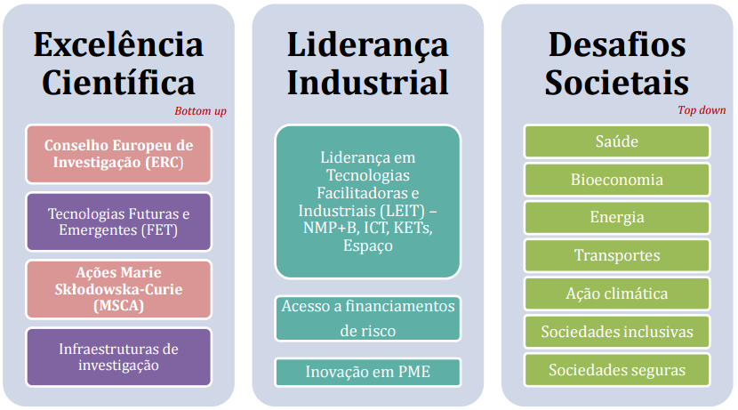

Slide 18
ICT
ICT
ICT
ICT
ICT
ICT
ICT
ICT
ICT

Slide 19
ICT nos Desafios Societais
Big Data
DS1 - Health: Big Data supporting Public Health policies
DS4 - Transport: Innovative ICT solutions for future logistics
DS6 - Inclusive Societies: Policy-development in the age of Big Data
DS6 - Inclusive Societies: European cultural heritage, access and analysis for a richer interpretation of the past
Robotics
DS1 - Health: Robotics-based solutions for active and healthy ageing
DS2 - Food: Robotics advances for precision farming

Slide 20
SME Instrument
Fast Track to Innovation
Gabinete de Promoção dos Programa Quadro ID&I

Slide 21
Quem deve concorrer ao SME Instrument?
PMEs de vocação altamente inovadora, de rápido crescimento e com ambições globais, com capacidade de introduzir alterações disruptivas nos mercados actuais.

Slide 22
Fase 1 – Viabilidade
20 PMEs
1M€
Fase 2 - Demonstração
1 PME
≈1M€

Slide 23
como participar
Gabinete de Promoção dos Programa Quadro ID&I

Slide 25
?

Slide 27
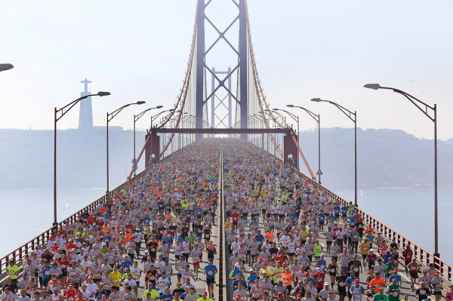

Slide 28
Networking
Plataformas Europeias
Pontos de Contacto Nacionais
Inscreva-se como avaliador

Slide 29
http://ec.europa.eu/digital-agenda/ICT2015

Slide 31
GPPQ Gabinete de Promoção do Programa-Quadro www.gppq.pt
Gestão do projeto
Relatórios, alterações ao contrato
Relatórios, Exploração dos resultados Auditorias da CE
1º contacto O que é o H2020 Como funciona?
Verificação
da ideia
A minha ideia integra-se numa call do H2020? Onde?
Avaliação da proposta por peritos independentes
Assinatura do contrato Procedimentos administrativos e legais
Preparação da proposta Construção do consórcio, escrita da proposta, procura de parceiros, revisão da proposta

Slide 32
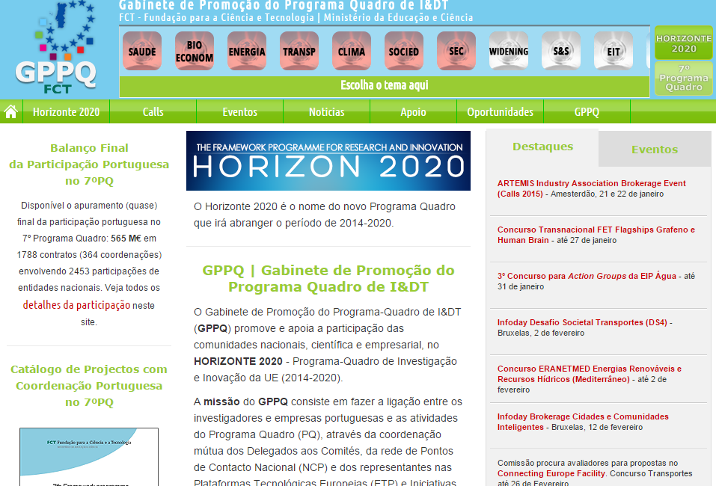
www.gppq.pt

Slide 33
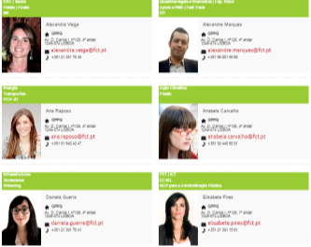
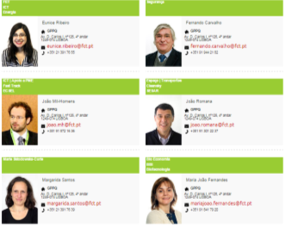
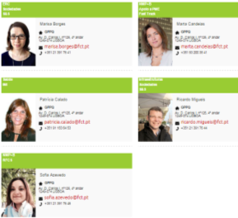
GPPQ – Gabinete de Promoção do Programa Quadro
20 NCPs especialistas nas várias áreas temáticas do H2020
Direção do GPPQ
Eduardo Maldonado | Ana Mafalda Dourado
(coordenador dos NCPs) (coordenadora adjunta)

Slide 34
João Mil-Homens
Ponto de Contacto Nacional Horizonte 2020
FCT/ANI
joao.mh@gppq.pt
918 721 636
Eunice Ribeiro | Elisabete Pires
Gabinete de Promoção dos Programa Quadro ID&I

